Slide 1
Google Declares War on the Password
Kyle Kodani

Slide 2
Why Passwords Don’t Work (HACKING)
Passwords are old, and haven’t aged well
Many, many accounts with similar passwords
Hacker needs no physical presence
What is a “strong” password?
Only protects against brute force attack
Vulnerable to keyloggers
Vulnerable to social engineering/phishing
The age of Google

Slide 3
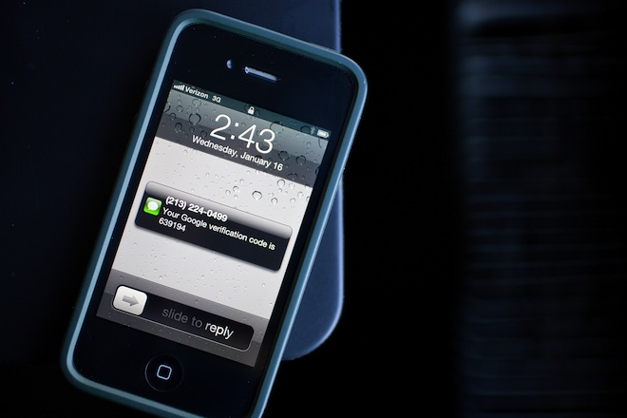
Current Countermeasures: Two-Factor Authentication

Slide 4
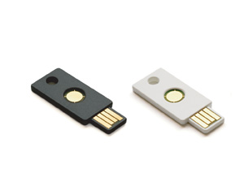
YubiKey By Yubico
25$ for one
Small, fits inside a wallet
Plugs into a USB port
Working on wireless connection
Compatible with popular operating systems and browsers
No need for extra software, change is made server side
Working on compatibility with mobile devices
Durable, no moving part or battery
Biggest problem is losing the key

Slide 5
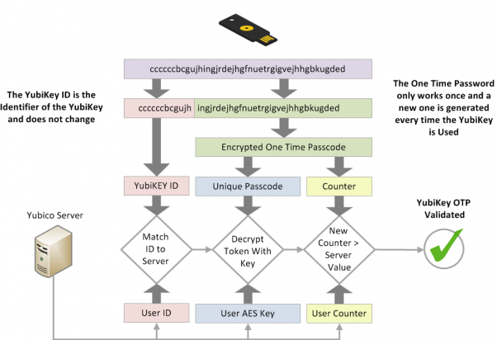
How it Works

Slide 6
YubiKey in Action
http://www.youtube.com/watch?v=yyABX0zAYTQ&list=UUX5_RgRVo8KVQ6yQy2lAatQ

Slide 7
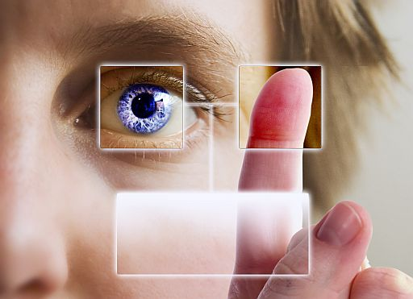
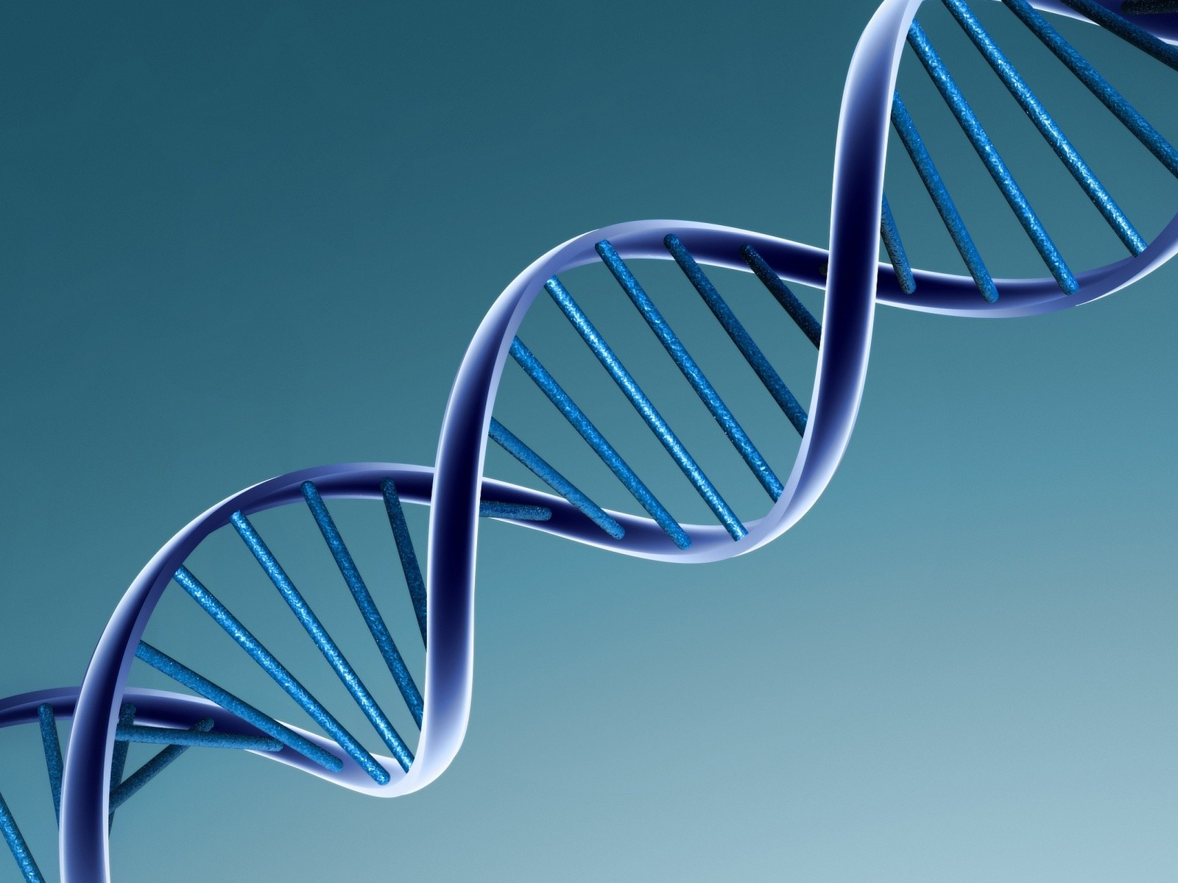
Biometrics: The Way of the Future?
Retinal scan, face scan, fingerprint, signature, voice, genetics, combination
Unique, secure
Requires extra hardware, software, data space

Slide 8
Articles
http://www.wired.com/gadgetlab/2012/11/ff-mat-honan-password-hacker/all/
http://www.wired.com/wiredenterprise/2013/01/google-password/all/
http://en.wikipedia.org/wiki/Password
http://www.yubico.com/products/yubikey-hardware/yubikey/technical-description/
http://en.wikipedia.org/wiki/Biometrics

